Slide 1



SQL
PROJECT
RESTAURANT OPERATIONS ANALYSIS

Slide 2


THE TASTE OF WORLD CAFE
Dishes Start
From 5$
ORDER NOW

Slide 3

THE ASSIGNMENT :
The Taste of the World Café debuted a new menu at the start of the year 2023.
We’ve been asked to analyze the customer data to see which dishes are doing well and not doing well.

Slide 4

THE OBJECTIVES:
1.Explore the menu_items table to get an idea of what’s on the menu.
2.Explore order_details table to get an idea of price range and date range.
3. Use both tables to understand how customers are reacting to the new menu.

Slide 5
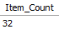

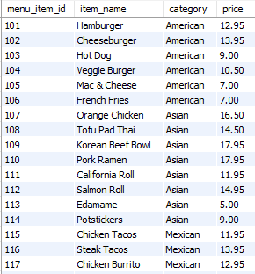
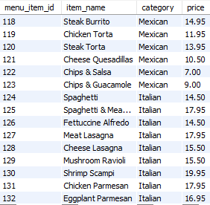
1.Exploring Menu_items table
2.Total number of items on the Menu
Query:
SELECT COUNT(DISTINCT()) AS ITEM_COUNT
FROM MENU_ITEMS;
1.Exploring menu_item tables
Query:
Result:
SELECT *
from menu_items;
Result:

Slide 6
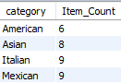
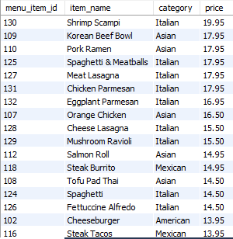
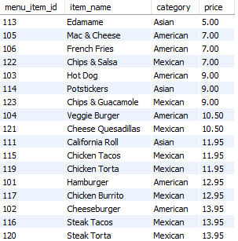

3.How many Items are
there in each category?
4.What are the Most expensive
items on the menu?
5.What are the Least expensive items on the Menu?
Query:
Query:
Query:
SELECT CATEGORY,
COUNT(DISTINCT(ITEM_NAME))
AS ITEM_COUNT
FROM MENU_ITEMS
GROUP BY CATEGORY;
SELECT * FROM MENU_ITEMS
ORDER BY PRICE DESC;
SELECT * FROM
MENU_ITEMS
ORDER BY PRICE ;
Result:
Result:
Result:

Slide 7
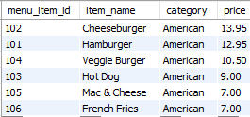
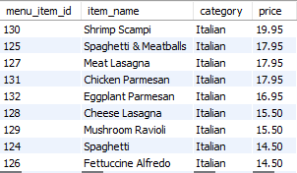

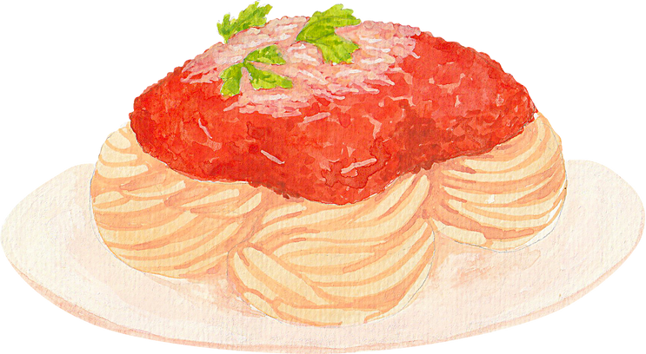
6.(a)What re the most and least expensive American items on the menu
6.(b) What are the most and
least expensive Italian items on the Menu?
Query:
Query:
SELECT *
FROM MENU_ITEMS
WHERE CATEGORY=”AMERICAN”
ORDER BY PRICE DESC;
SELECT *
FROM MENU_ITEMS
WHERE CATEGORY=”ITALIAN”
ORDER BY PRICE DESC;
Result:
Result:

Slide 8

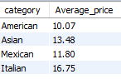

7.What is the average dish
price in each category?
Query:
Result:
SELECT CATEGORY,
ROUND(AVG(PRICE),2) AS AVERAGE_PRICE
FROM MENU_ITEMS
GROUP BY CATEGORY;

Slide 9

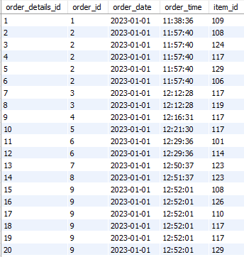
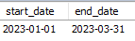
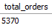
2.What is the date range of the table?
2.Exploring Order_details table
1.Explore order details table:
Query:
SELECT
MIN(ORDER_DATE) AS START_DATE,
MAX(ORDER_DATE) AS END_DATE
FROM ORDER_DETAILS;
Query:
SELECT * FROM ORDER_DETAILS;
Result:
Result:
3.How many orders were made during this date range?
Query:
SELECT COUNT(DISTINCT ORDER_ID)
AS TOTAL_ORDERS FROM ORDER_DETAILS
WHERE ORDER_DATE
BETWEEN '2023-01-01' AND '2023-03-31';
Result:

Slide 10
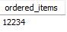
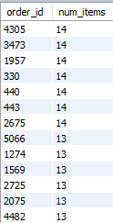
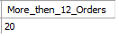

4.How Many items were ordered in the date range?
5.What is the maximum number
of items per order?
6.How many orders had more than 12 items?
Query:
Query:
Query:
SELECT
COUNT(ORDER_DETAILS_ID)
AS ORDERED_ITEMS
FROM ORDER_DETAILS;
SELECT ORDER_ID,
COUNT(ITEM_ID) AS NUM_ITEMS
FROM ORDER_DETAILS
GROUP BY ORDER_ID
ORDER BY NUM_ITEMS DESC;
SELECT COUNT(*) AS MORE_THEN_12_ORDERS FROM
(SELECT ORDER_ID,COUNT(ITEM_ID)
FROM ORDER_DETAILS
GROUP BY ORDER_ID
HAVING COUNT(ITEM_ID) >12) AS NUM_ORDERS;
Result:
Result:
Result:

Slide 11
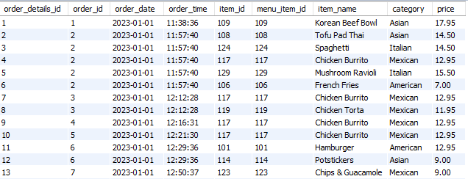
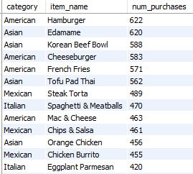
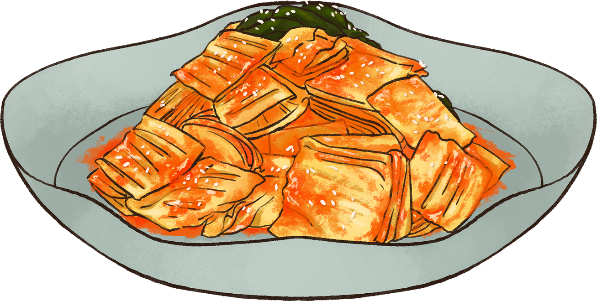
3.ANALYZING CUSTOMER BEHAVIOUR
1.Joining both the tables using Joins.
2.What were the most ordered items?
What categories were they in?
Query:
SELECT * FROM ORDER_DETAILS O
LEFT JOIN MENU_ITEMS M
ON O.ITEM_ID= M.MENU_ITEM_ID;
Query:
SELECT CATEGORY,ITEM_NAME,
COUNT(ORDER_DETAILS_ID) AS NUM_PURCHASES
FROM ORDER_DETAILS O
LEFT JOIN MENU_ITEMS M
ON O.ITEM_ID= M.MENU_ITEM_ID
GROUP BY ITEM_NAME,CATEGORY
ORDER BY NUM_PURCHASES DESC;
Result:
Result:

Slide 12
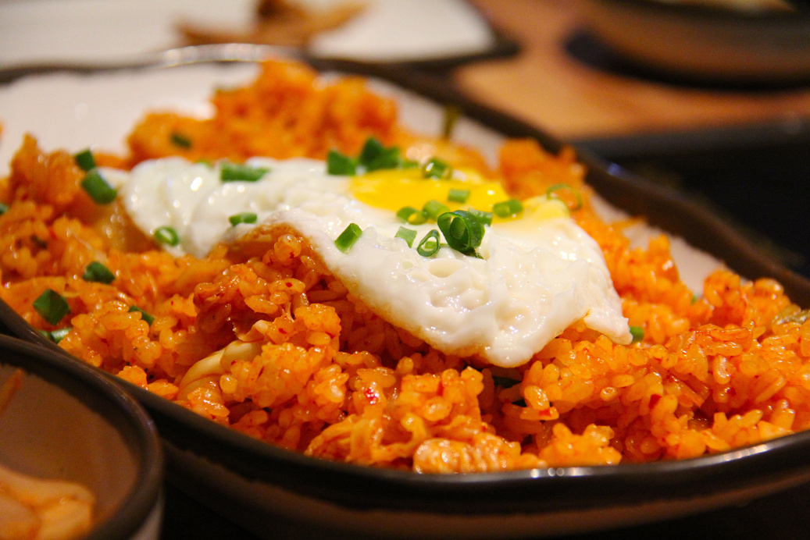
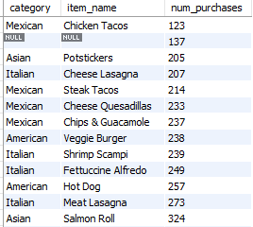
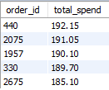
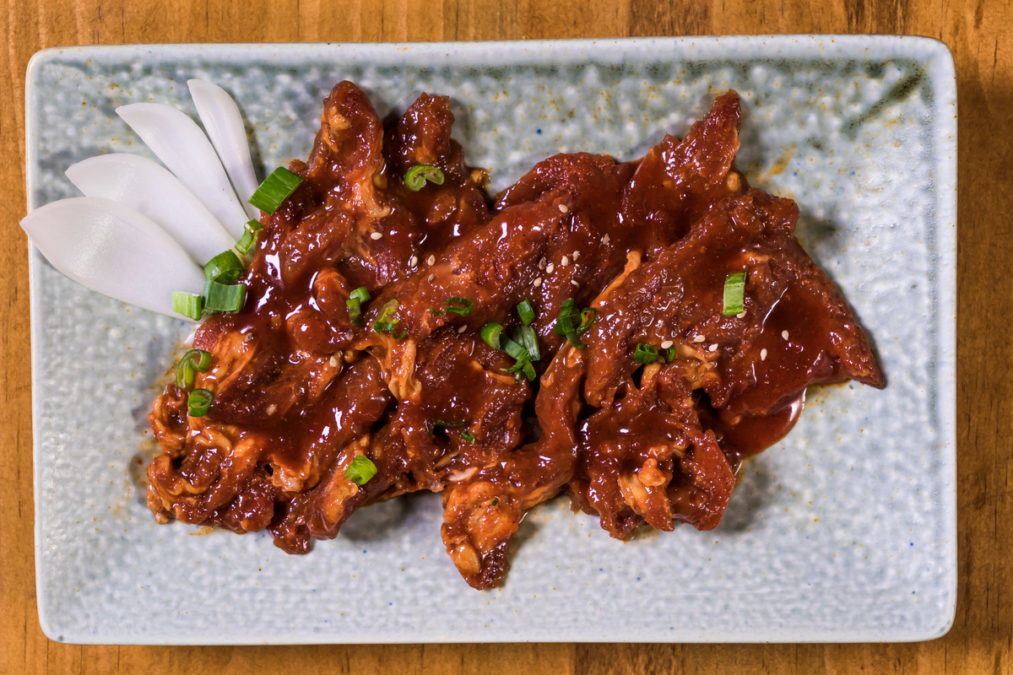
3.What were the least ordered items?
What categories were they in?
4.What were the top 5 orders that spent the most money?
Query:
Query:
SELECT CATEGORY,ITEM_NAME,
COUNT(ORDER_DETAILS_ID) AS NUM_PURCHASES
FROM ORDER_DETAILS O
LEFT JOIN MENU_ITEMS M
ON O.ITEM_ID= M.MENU_ITEM_ID
GROUP BY ITEM_NAME,CATEGORY
ORDER BY NUM_PURCHASES ;
SELECT ORDER_ID,SUM(PRICE) AS TOTAL_SPEND
FROM ORDER_DETAILS O
LEFT JOIN MENU_ITEMS M
ON O.ITEM_ID= M.MENU_ITEM_ID
GROUP BY ORDER_ID
ORDER BY TOTAL_SPEND DESC
LIMIT 5;
Result:
Result:

Slide 13


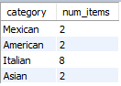
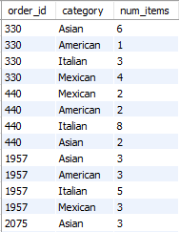
5.View the details of the highest spend order.
Which specific items were purchased?
6.View the details of the top 5 highest spend orders
Query:
Query:
SELECT CATEGORY,
COUNT(ITEM_ID) AS NUM_ITEMS
FROM ORDER_DETAILS O
LEFT JOIN MENU_ITEMS M
ON O.ITEM_ID= M.MENU_ITEM_ID
WHERE ORDER_ID=440
GROUP BY CATEGORY;
SELECT ORDER_ID,CATEGORY,
COUNT(ITEM_ID) AS NUM_ITEMS
FROM ORDER_DETAILS O
LEFT JOIN MENU_ITEMS M
ON O.ITEM_ID= M.MENU_ITEM_ID
WHERE ORDER_ID IN (440,2075,1957,330,2675)
GROUP BY CATEGORY,ORDER_ID;
Result:
Result:

Slide 14

INSIGHTS
RECOMMENDATIONS
1. There are 32 new dishes on the menu
2. Count of dishes from different categories American 6 , Asian 8,
Italian 9, Mexican 9
3. Edamame from Asian is the least expensive ($5)
4. Shrimp Scampi from Italian is the most expensive ($19.95)
5. Italian dishes are the most expensive (Average price $16.75)
6. American dishes are most affordable (Average price $10.07)
7. Total Orders 5370, Number of items ordered 12234
8. Maximum Items per order is 14
9. Most ordered items are American (Hamburger (5.08%)) and Asian (Edamame (5.06%))
10. Highest spending order $192.15
11. 'Customers spent the most on the 'Korean Beef Bowl' from Asian category, 'Spaghetti & Meatballs' from Italian, 'Steak Torta' from Mexican, 'Cheeseburger' from Mexican.
12. Despite the higher prices of Italian dishes, customers still prefer to purchase them.
What Cuisines do our top spenders usually like to order from?
The Highest Spent Orders tend to spend a lot on Italian food.
We should keep these expensive Italian foods in our menu
because people seem to be ordering
them a lot ,especially our highest spend customers.

Slide 15


THANK YOU!
SQL Data Analysis
By
Aamir Afzal

